Slide 1
Multi-Exposure Fusion

Slide 2
Papers
Joint HDR Denoising and Fusion: A Real-World Mobile HDR Image Dataset (2023)​.
EAT: Multi-Exposure Image Fusion with Adversarial Learning and Focal Transformer (2025)
MobileMEF: Fast and Efficient Method for Real-Time Mobile Multi-Exposure Fusion(2025)
Proposed Approach

Slide 3
Joint HDR Denoising and Fusion
LDR-HDR image pairs in the RAW image domain, captured using mobile phones,
ISO settings in the dataset range from 100 to 6400, covering a variety of noise levels,
This paper jointly performs HDR denoising and fusion, ensuring better noise suppression and feature alignment in a single framework.
Proposed architecture contains three components:
Pyramid Cross Attention Alignment Module to align features from neighborhood frames to the reference frame,
Attention Fusion Module to suppress harmful features from misaligned, over-exposed and under-exposed area,
Context-aware Transformer block to extract globally long-range feature,

Slide 4
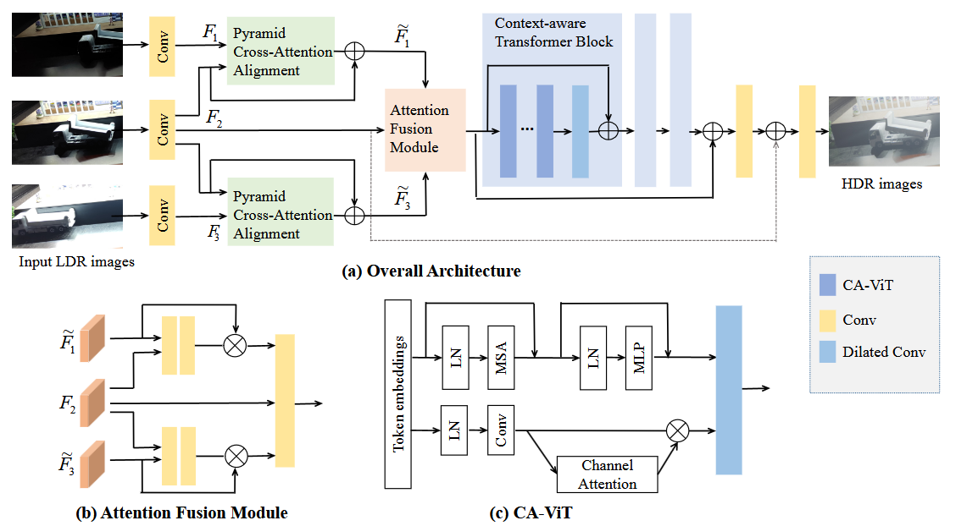
Joint HDR Denoising and Fusion

Slide 5
Joint HDR Denoising and Fusion
To handle large motions and noise, the method constructs a multi-scale feature pyramid,
The pyramid helps align features at different scales,
Cross-attended feature aggregates information from multiple exposure frames,
Attention transfer mechanism, where attention weights computed at coarser scales are used to guide alignment at finer scales.

Slide 6
EAT: Multi-Exposure Image Fusion with Adversarial Learning and Focal Transformer
Traditional MEF methods rely on handcrafted feature extraction or CNN-based deep learning, which cannot model long-range dependencies well,
EAT introduces:
Focal Transformer (FTM) to focus on important regions, selectively exploit multi-exposure features and model long-range multi-exposures relationship
Adversarial Learning to generate more realistic and high-quality fused images and whether the fusion results are indiscernible from the gt.

Slide 7
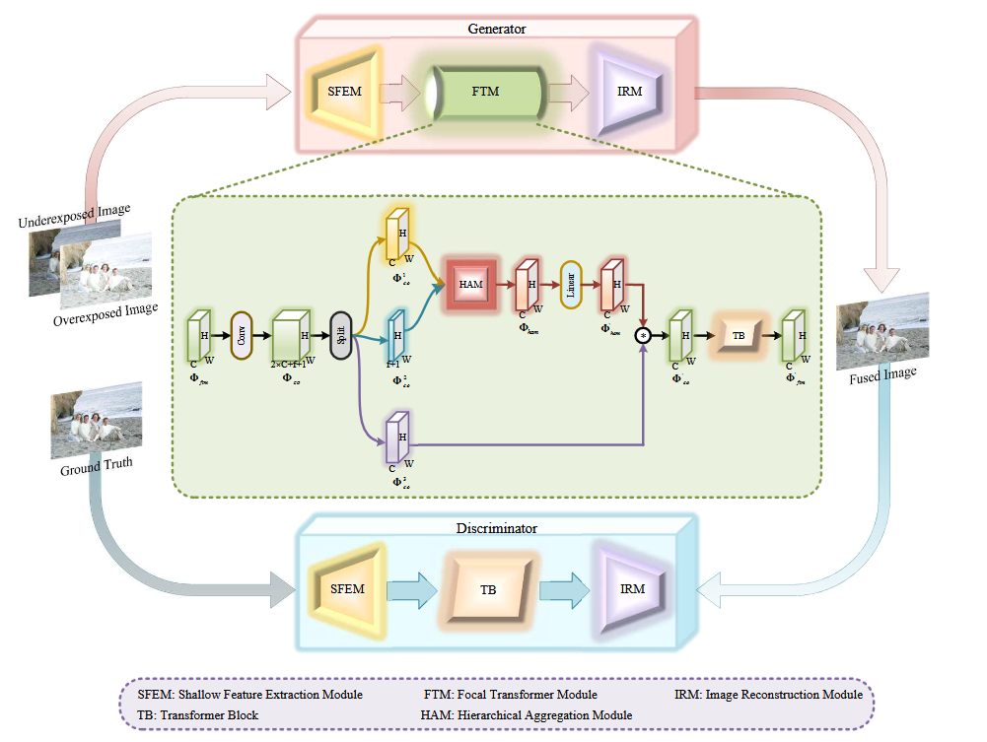
EAT

Slide 8
EAT
Shallow Feature Extraction Module (SFEM) extracts low-level features from the underexposed and overexposed input images,
Focal Transformer Module (FTM) focuses on more informative regions, contains three steps:
Hierarchical Aggregation- Extracts contextual information.
Channel Interaction- Exchanges feature information across different channels.
Transformer Block (TB)- Models long-range dependencies using self-attention.
Image Reconstruction Module (IRM) merges features and generates the final fused image

Slide 9
Proposed Approach
Pyramid Cross-Attention (PCA) Module (for alignment and feature aggregation).
Adversarial Learning (for perceptual realism)
Fusion Network (to merge aligned multi-exposure features into a high-quality HDR image)

Slide 10
MobileMEF
Existing MEF methods are computationally expensive and not suitable for mobile devices.
Develop an efficient, real-time MEF method optimized for smartphones, capable of processing 4K images in under 2 seconds.

Slide 11
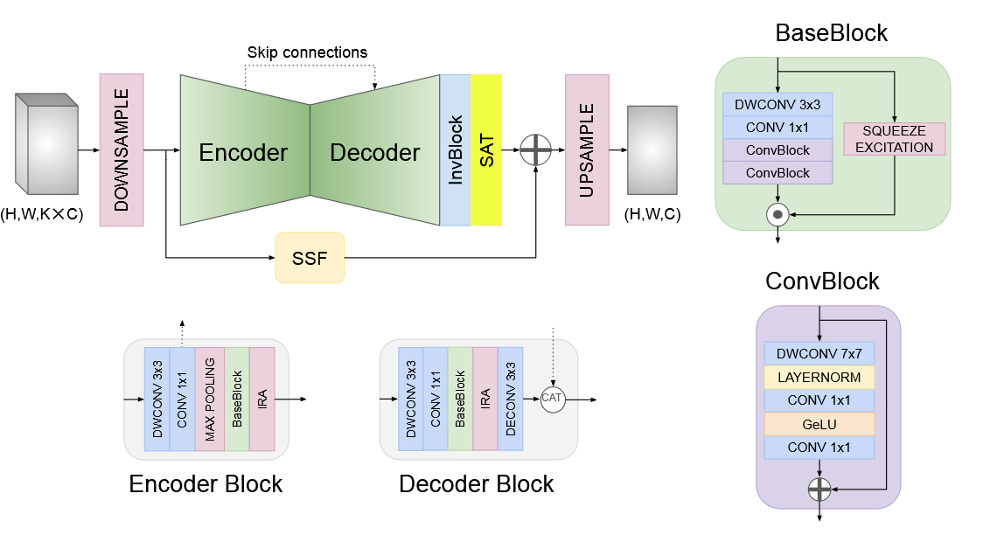
MobileMEF

Slide 12
MobileMEF
Single-Scale Fusion (SSF) Bypass Module- Eliminates complex multi-scale decomposition to improve efficiency.
YUV Color Space Processing - Reduces computational load by processing luminance (Y) separately and downsampling chromaticity (UV)
Gradient Loss with Cropping - Crops patches before computing gradient loss, reducing memory usage while preserving details.
Fast & Efficient- Runs 200x faster than previous methods while maintaining high-quality results.

